Slide 1
Automated Flow Cytometry Analysis
R. Burke Squires

Slide 2
License and Sources
License
SourceS
This material is licensed under the Creative Commons Attribution-ShareAlike 4.0 License.
Ryan Brinkman, PhD
Bioinformatics.ca

Slide 3
Outline
Morning
Afternoon
Flow Cytometry Review
Flow Cytometry Standards and Analysis (FlowCAP)
Automated Flow Cytometry Analysis

Slide 4
Flow Cytometry Review

Slide 5
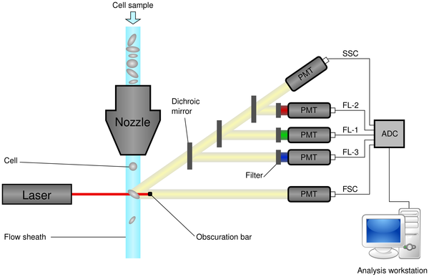

Schematic Diagram Of A Flow Cytometer
O'Neill K, Aghaeepour N, Špidlen J, Brinkman R (2013) Flow Cytometry Bioinformatics. PLOS Computational Biology 9(12): e1003365. doi:10.1371/journal.pcbi.1003365
http://journals.plos.org/ploscompbiol/article?id=10.1371/journal.pcbi.1003365
Notes:
Schematic diagram of a flow cytometer, showing focusing of the fluid sheath, laser, optics (in simplified form, omitting focusing), photomultiplier tubes (PMTs), analogue-to-digital converter, and analysis workstation.

Slide 6
Schematic Diagram Of A Flow Cytometer
O'Neill K, Aghaeepour N, Špidlen J, Brinkman R (2013) Flow Cytometry Bioinformatics. PLOS Computational Biology 9(12): e1003365. doi:10.1371/journal.pcbi.1003365
http://journals.plos.org/ploscompbiol/article?id=10.1371/journal.pcbi.1003365
Notes:
Schematic diagram of a flow cytometer, showing focusing of the fluid sheath, laser, optics (in simplified form, omitting focusing), photomultiplier tubes (PMTs), analogue-to-digital converter, and analysis workstation.

Slide 7
Fluorescent Light Is Filtered So That Each PMT Detects A Specific Wavelength
http://www.abcam.com/protocols/introduction-to-flow-cytometry

Slide 8
Fluorescent Light Is Filtered So That Each PMT Detects A Specific Wavelength
http://www.abcam.com/protocols/introduction-to-flow-cytometry

Slide 9
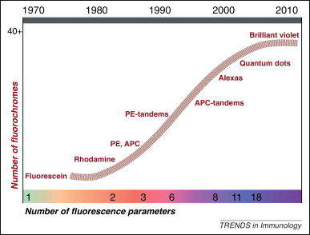
Fluorochromes
History
Bendall, S. C., Nolan, G. P., Roederer, M. & Chattopadhyay, P. K. A Deep Profiler’s Guide to Cytometry. Trends in Immunology 33, 323–332 (2012).

Slide 10
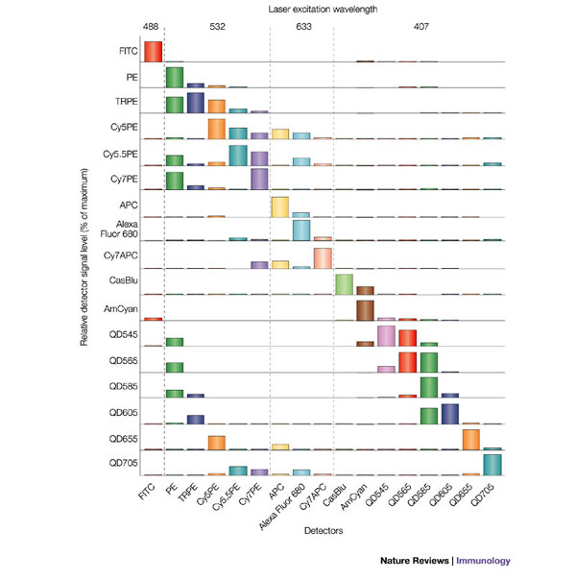
Fluorochromes

Slide 11
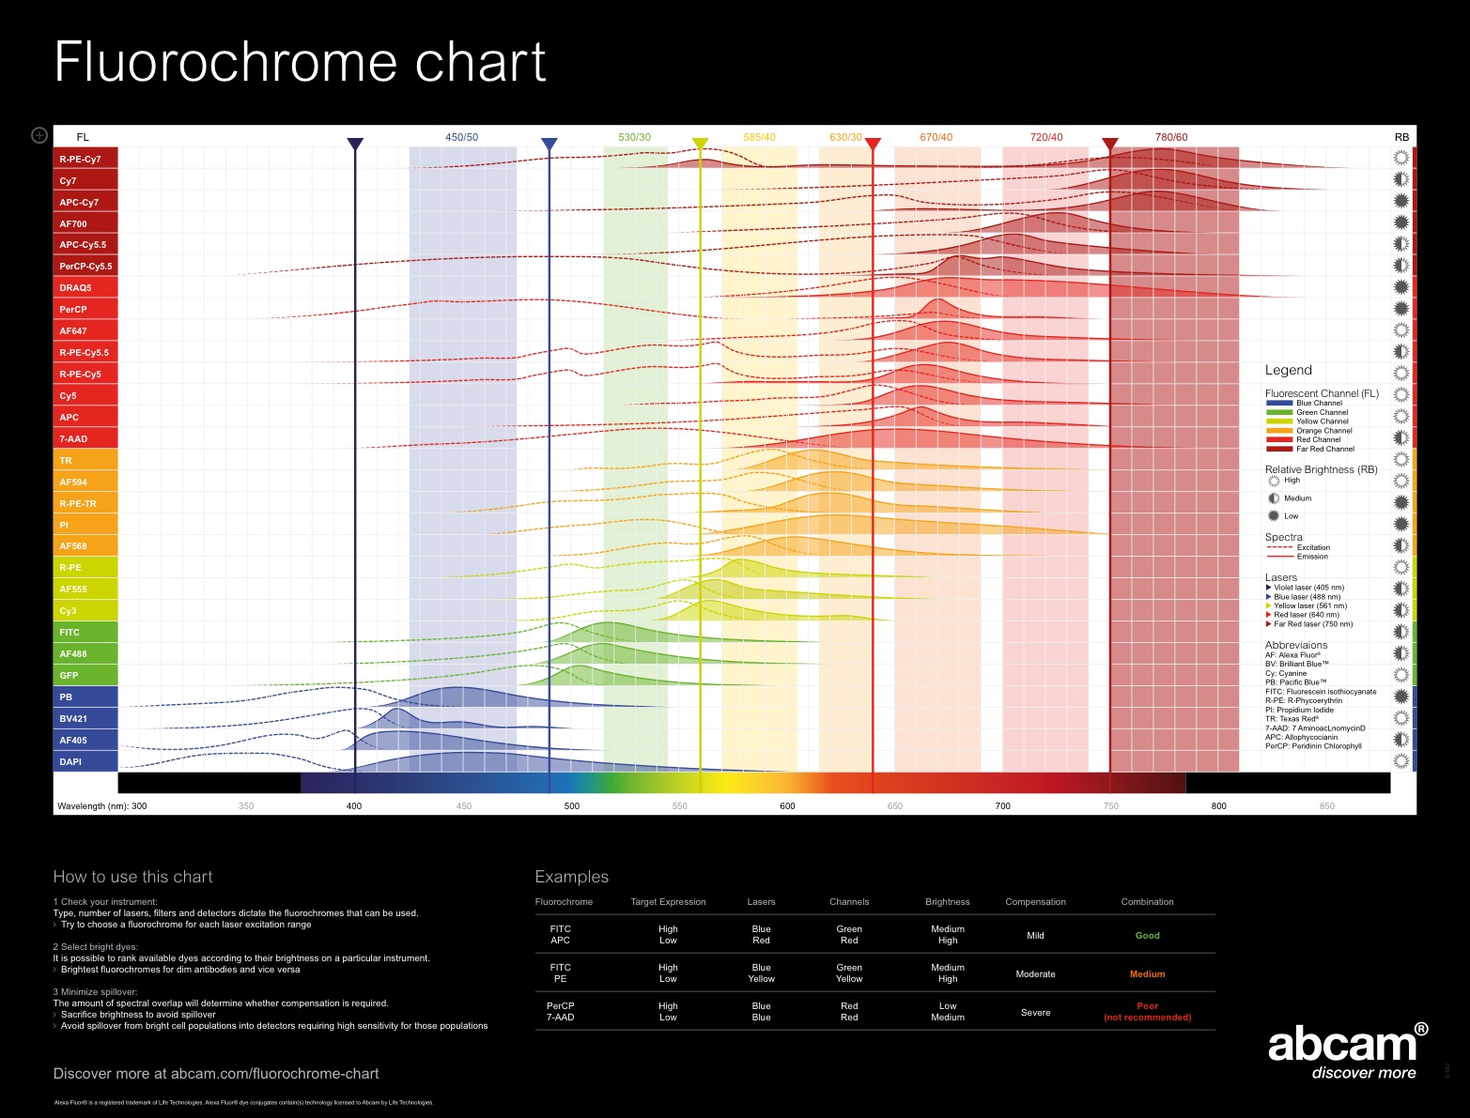

Slide 12
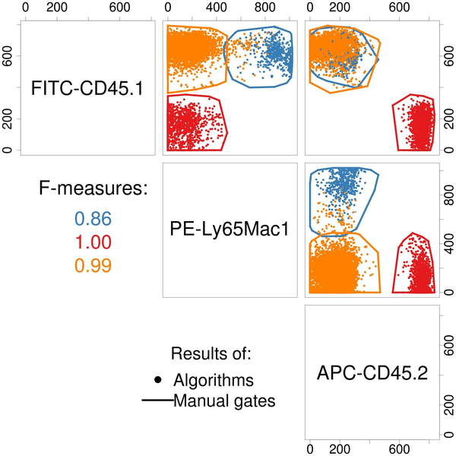
Manual Gating (polygons) Vs. Automated Gating (colored dots)
O'Neill K, Aghaeepour N, Špidlen J, Brinkman R (2013) Flow Cytometry Bioinformatics. PLOS Computational Biology 9(12): e1003365. doi:10.1371/journal.pcbi.1003365
http://journals.plos.org/ploscompbiol/article?id=10.1371/journal.pcbi.1003365

Slide 13
Automated Flow Cytometry Analysis

Slide 14
Automated Flow Cytometry Analysis
“Automated algorithms for flow cytometry data analysis have reached a level of maturity that enables them to match and in many cases exceed the results produced by human experts.”¹
Supervised gating (diagnosis): OpenCyto, flowDensity²
Unsupervised biomarker discovery: FlowReMi, flowType/RchyOptimyx³
¹Aghaeepour et al., Nature Methods, 2013
²Malek et al., Bioinformatics, 2014
³O′Neill et al., Bioinformatics, 2014
Ryan Brinkman

Slide 15
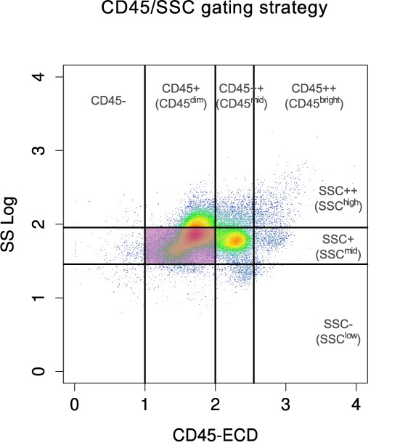
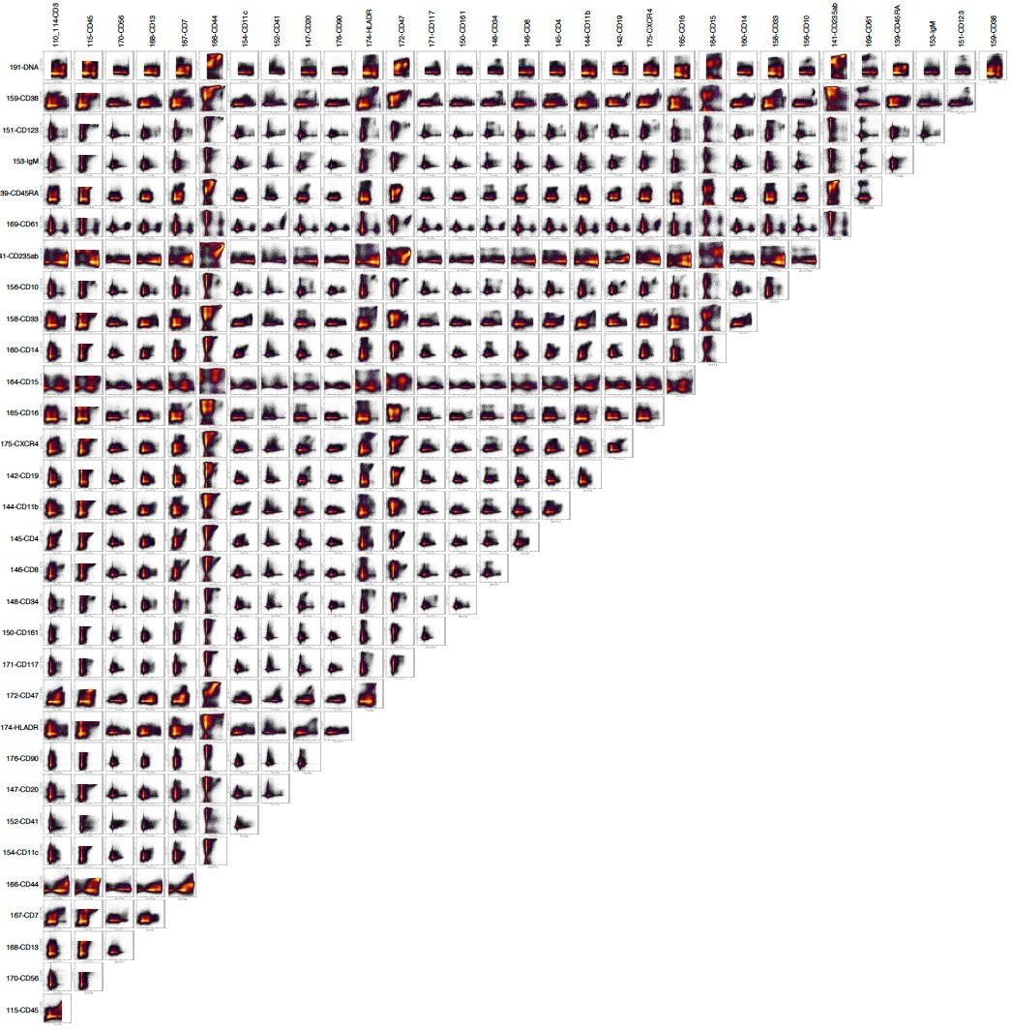
Big Flow Cytometry Data
Automated Analysis of flow cytometry data in R/Bioconductor
 | 1985¹ | 2012² | 2016+³
Samples | 1 | 466 | 77,000
Dimensions | 5 | 13 | 50
Cells | 50,000 | 400,000 | 1,000,000
Datasets | 2.5^5 | 2.5^9 | 4^11
¹ Murphy Cytometry (1985)
² Aghaeepour et al. Bioinformatics (2012)
³ International Mouse Phenotyping Consortium (2015)
Ryan Brinkman

Slide 16
Can Manual Analysis of “High-Dimensional” Data Be Improved Upon?
Time consuming, especially for “discovery”
Analysis guided by history with limited, intuitive exploration
Rarely (ever?) examine entire multidimensional dataset
Significant cross-individual variability (>10%)
No appropriate statistical basis to assess relative significance
Not fun (?)
“Unfortunately, the use of three or more independent fluorescent parameters complicates the analysis of the resulting data significantly.” Murphy Cytometry (1985)
“Despite the technological advances in acquiring [30] parameters per single cell, methods for analyzing multidimensional single-cell data remain inadequate.” Qiu et al. Nature Biotechnology (2011)
Ryan Brinkman

Slide 17

>50 Peer-reviewed, Free, Open Source Software Tools
45 R/BioConductor for data analysis
A scripted approach to high throughput data analysis
Non-interactive, self-documented, reproducible
Breaks problem into smaller pieces (packages)
Modules can plug-in & swap-out
Collaborative, cross-platform development environment
9 additional software tools
Java, Python, Matlab, C++
Stand alone (single problem/solution)
Ryan Brinkman

Slide 18
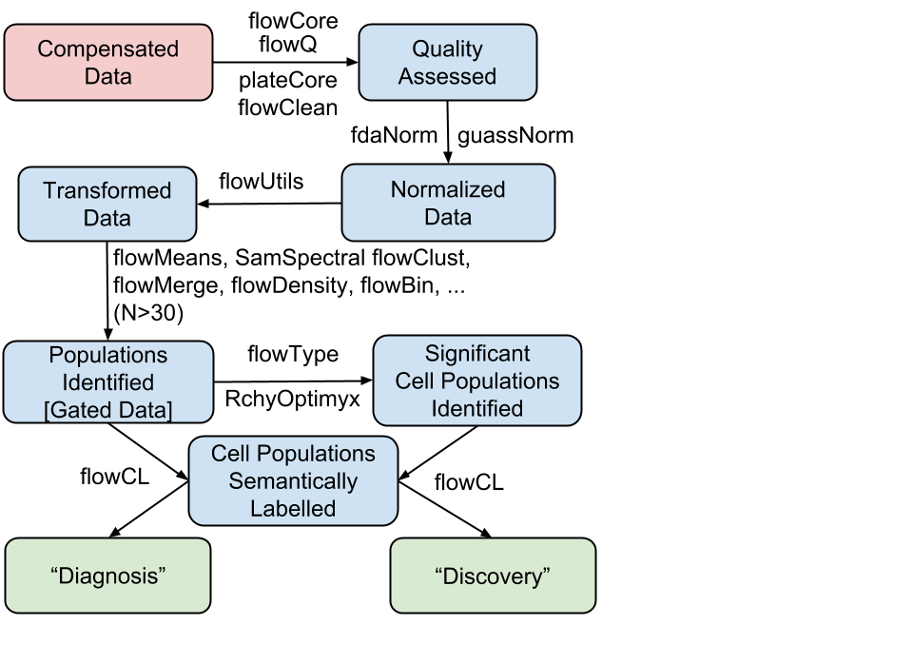
BioConductor’s Open, Extensible Infrastructure Packages are Interoperable & Interchangeable
Ryan Brinkman

Slide 19
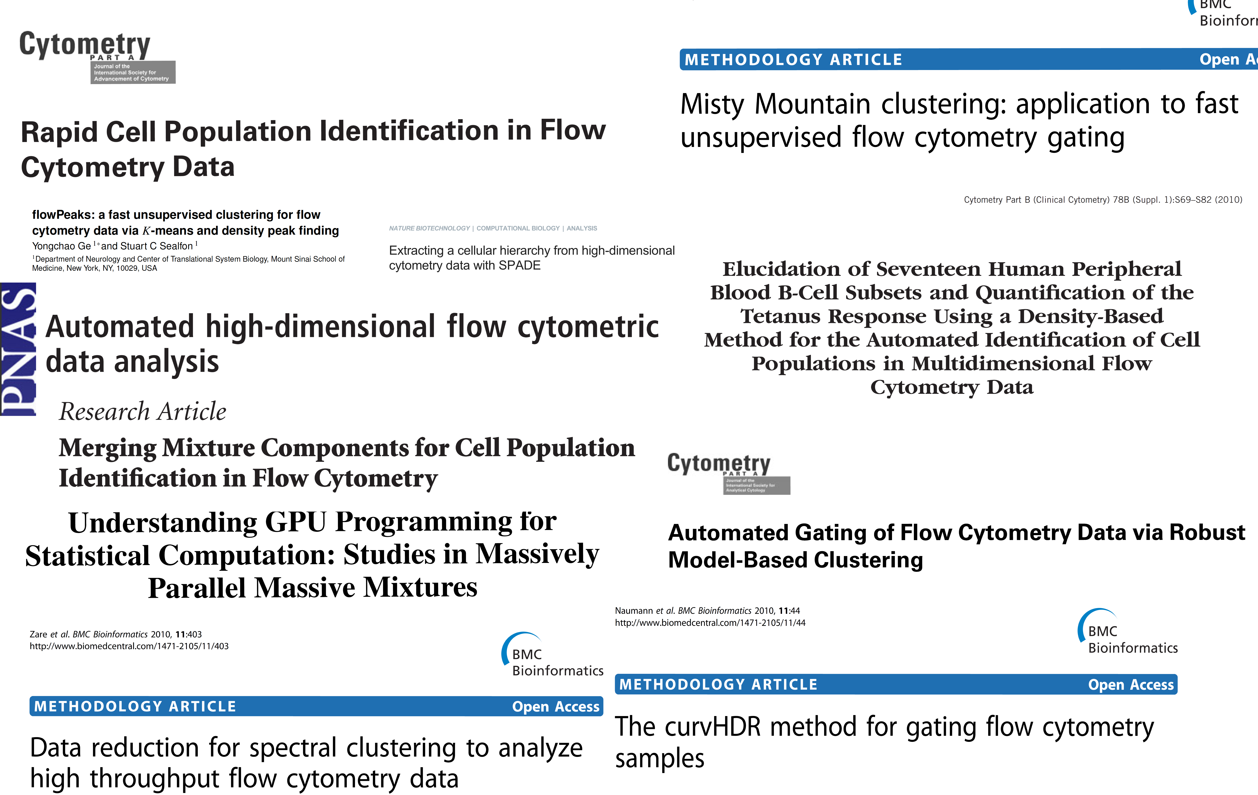
Which Automated Analysis Methods to Use?
Ryan Brinkman

Slide 20
Flow Cytometry Standards and Analysis (FlowCAP)

Slide 21
FlowCAP (Critical Assessment of Automated Analysis Methods)
Community-based evaluation of flow bioinformatics tools
FlowCAP-I (2010): Matching manual gating (1st gen tools)
FlowCAP-II (2011): (Too simple) sample classification
FlowCAP-III (2012): 2nd generation automated gating tools
FlowCAP-IV (2014): (Hard) Biomarker discovery
http://flowcap.flowsite.org
Ryan Brinkman

Slide 22
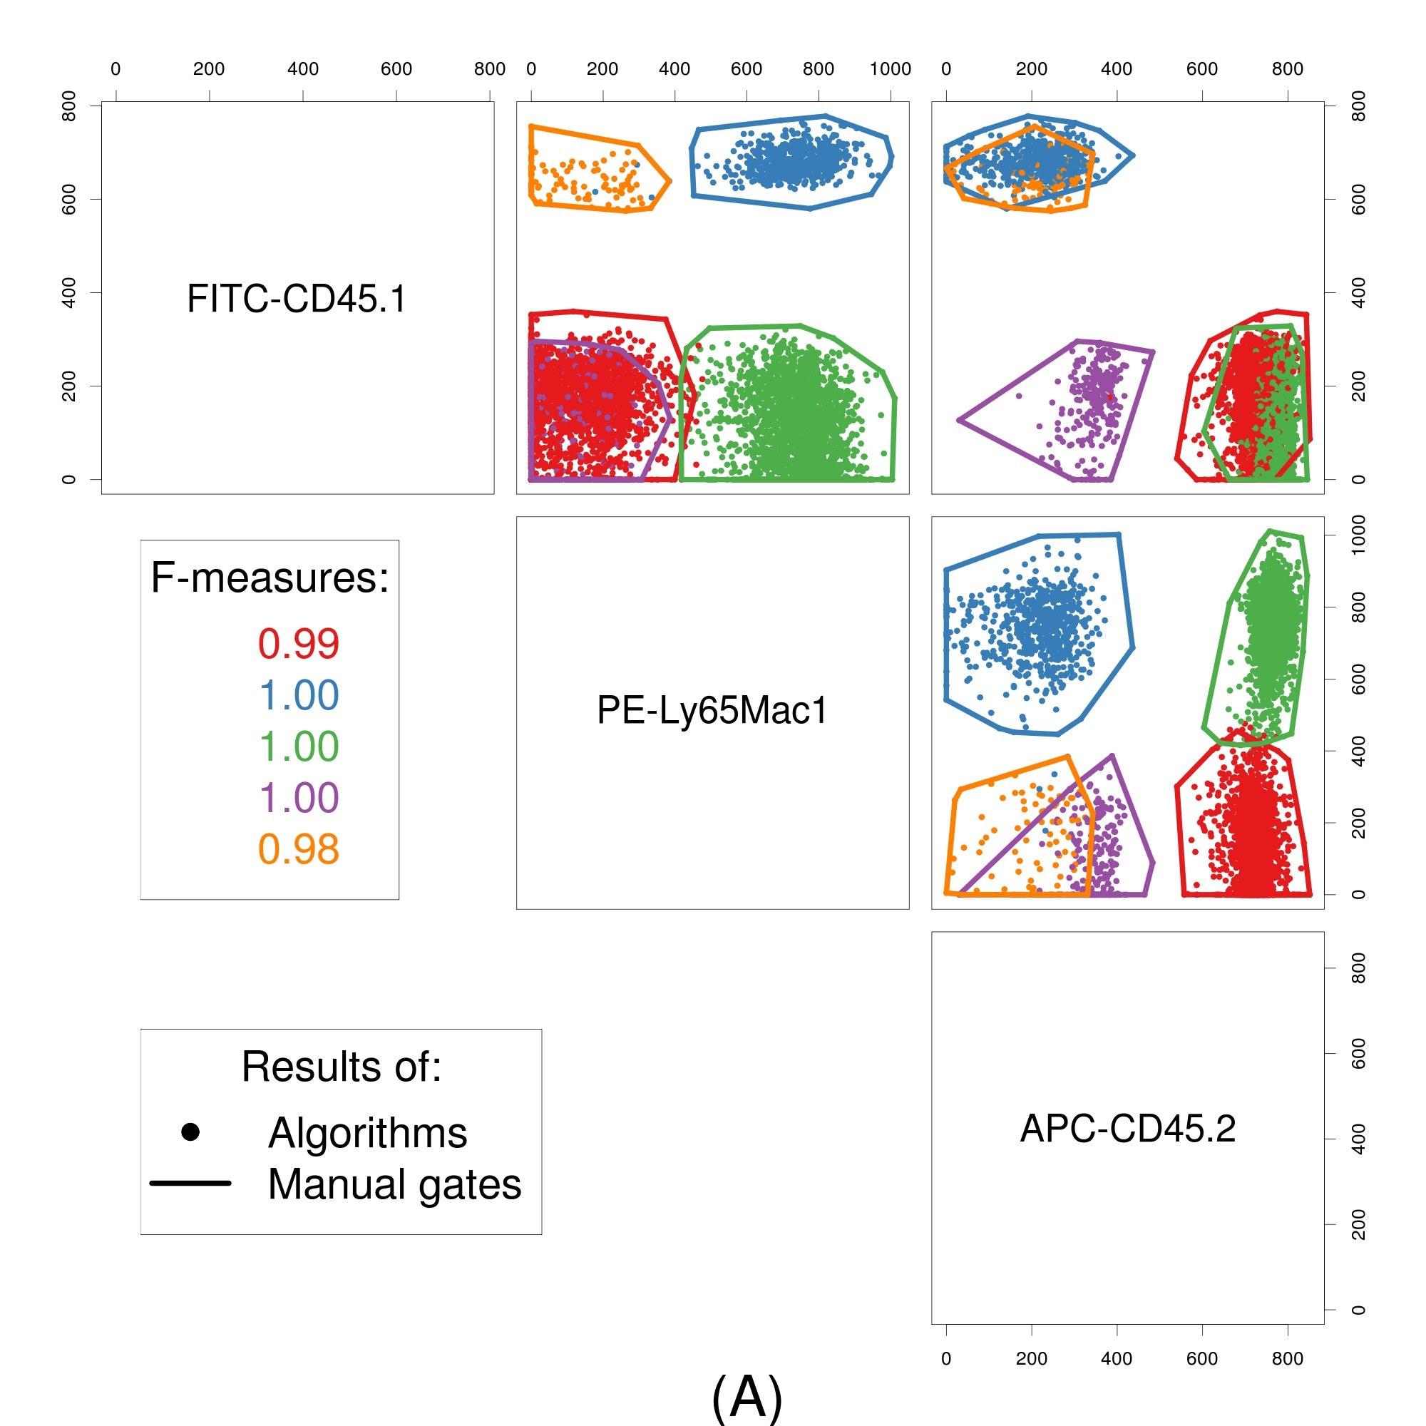
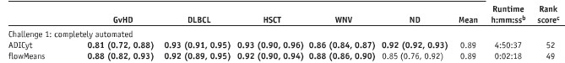
FlowCAP-I: Unsupervised gating (discovery) = humans’
Individual performance can vary on specific cell populations (might not matter)
*Aghaeepour et al., Nature Methods (2013)
http://flowcap.flowsite.org
15 diﬀerent tools on 5 datasets
Ryan Brinkman

Slide 23
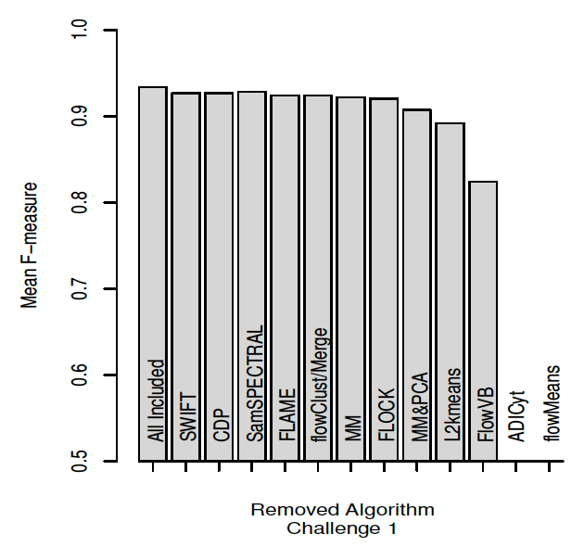
There is No Single Best Gating Solution
Ryan Brinkman

Slide 24
FlowCAP-II: Tools for Clinical Classification
Several algorithms performed perfectly
There were misclassifications
 | Sensitivity | Specificity | Accuracy
flowType-FeaLect | 1.00 | 1.00 | 1.00
flowPeaks | 1.00 | 1.00 | 1.00
SPADE | 1.00 | 1.00 | 1.00
… | … | … | …
Ryan Brinkman

Slide 25
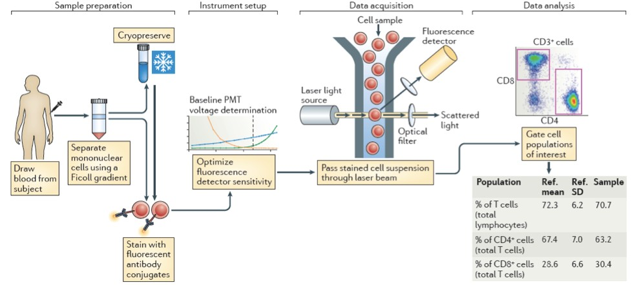
FlowCAP-III: Reducing Variability in Translational Immunology
Sample prep (BD lyoplates), Instrumentation, Acquisition, Automated Analysis
Maecker et al. Nature Reviews Immunology, 2012
Ryan Brinkman
Notes:
Sample prep (BD lyoplates), Instrumentation, Acquisition, Automated Analysis

Slide 26
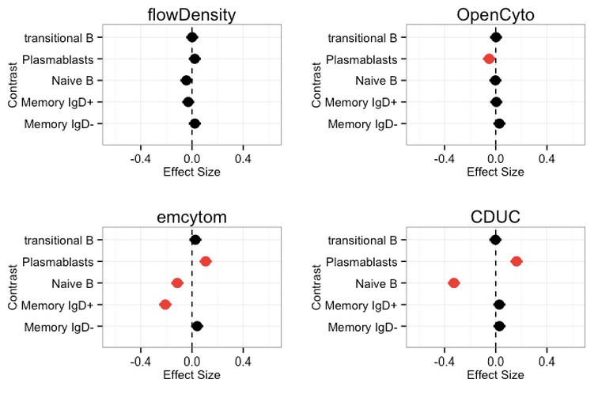
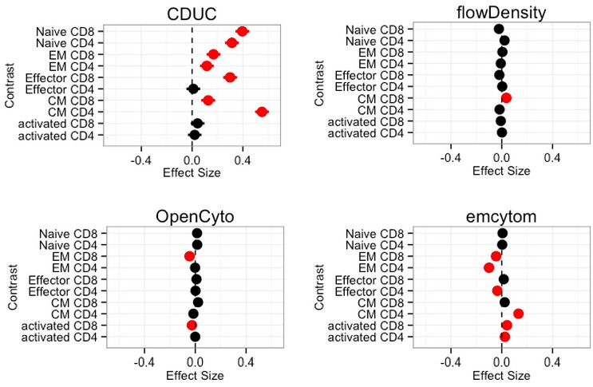
FlowCAP-III: Supervised Analysis for “Diagnostics”
2 automated tools can match human gating
9 clinical sites, 4 replicates of cryopreserved cells per site.
Centralized gating of data based on a consensus best approach.
Automated algorithms vs. centralized gating.
Ryan Brinkman

Slide 27
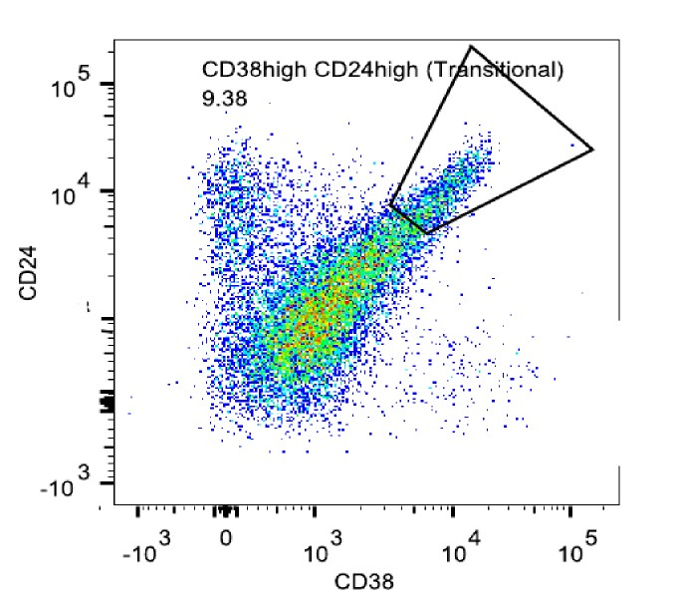
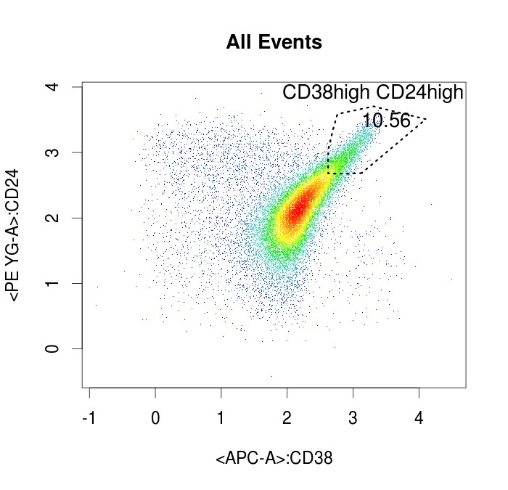
Gating Transitionals From Lymphocytes
Manual: 9.38
Auto: 10.56
Manual: 9.38
Ryan Brinkman

Slide 28
FlowCAP-III Conclusion: Stop Manually Gating
Supervised gating can match manual analysis when it is data-driven
Automated gating is unbiased relative to manual gating
Variability is as low or lower than manual gating
Even when biased, the bias is associated with populations that have low cell counts and CV is lower than manual gating
Not following SOPs can result in large variability
*Finak et al., Nature Scientific Reports (2016)
Ryan Brinkman

Slide 29
FlowCAP-IV: Unsupervised Clustering and Classification
Biomarker discovery
388 patients (split training and test)
14 parameter data
Predict survival time (onset of HIV) & identify biomarkers
Thorough manual analysis (NIH/VRC) had failed to identify any biomarker
*Aghaeepour et al., Cytometry A (2016)
Ryan Brinkman

Slide 30
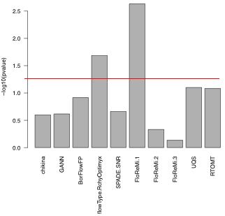
FlowCAP-IV: Unsupervised Clustering and Classification
Two similar methods (included flowDensity/flowType) had significant results on test data
*p-value not adjusted for testing multiple cell populations, but not algorithms
Ryan Brinkman

Slide 31
Automated Analysis For Discovery And Diagnosis In Big Flow Cytometry Data
flowDensity: Pipeline for Diagnosis
flowType / RchyOptimyx: Pipeline for Discovery
Finds what you want to find, how you want find it
Based on density estimation techniques
Seconds per FCS file
Identical to the manual practice of 2D gating
You split FCS files into groups
Pipeline finds best cell populations that correlate with that split
One graph summary of very large datasets
Can be used as input to large multi-group studies
Ryan Brinkman

Slide 32
What You Can Do To Get Started?

Slide 33
What You Can Do To Get Started
Practical Considerations for Automated Analysis
Don’t waste your time on 12 clinical samples
Your study probably isn’t suﬃciently powered for unsupervised analysis
Don’t waste your time on automated discovery using 6 colors
Automated analysis will find everything you found by hand
Good bioinformatics can’t save bad data
Discovery analysis is hypothesis generating
Finding cell populations that don’t “make sense” will happen
Its OK to ask for help (and to attend training! ☺ )
Ryan Brinkman

Slide 34
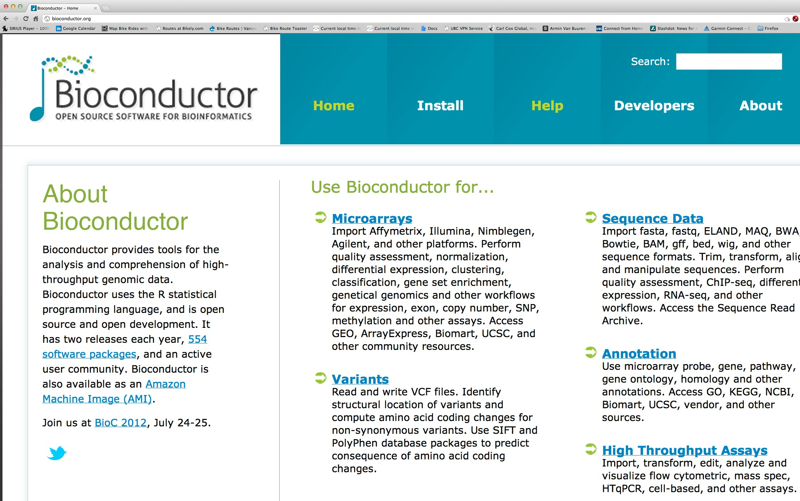
Learning R: BioConductor.org
Ryan Brinkman

Slide 35
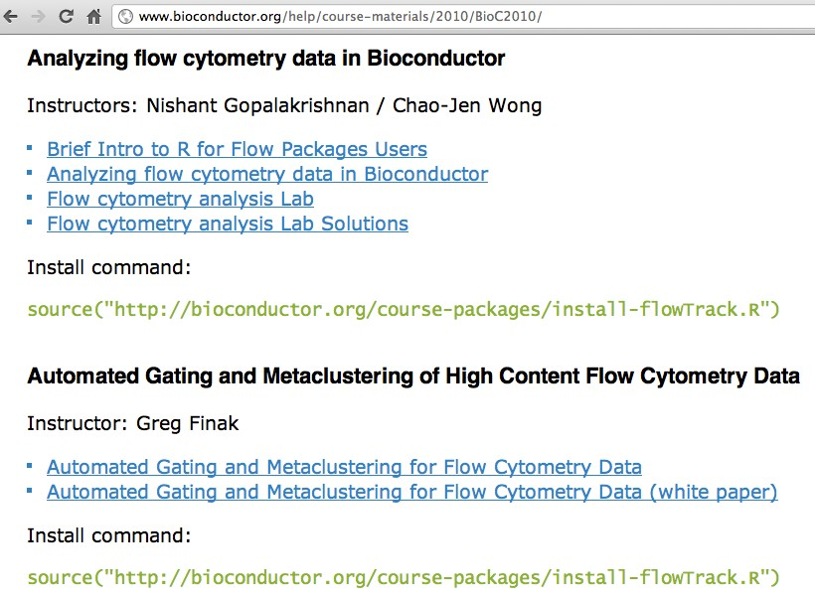
What next? BioC Courses & Mailing List
Ryan Brinkman

Slide 36
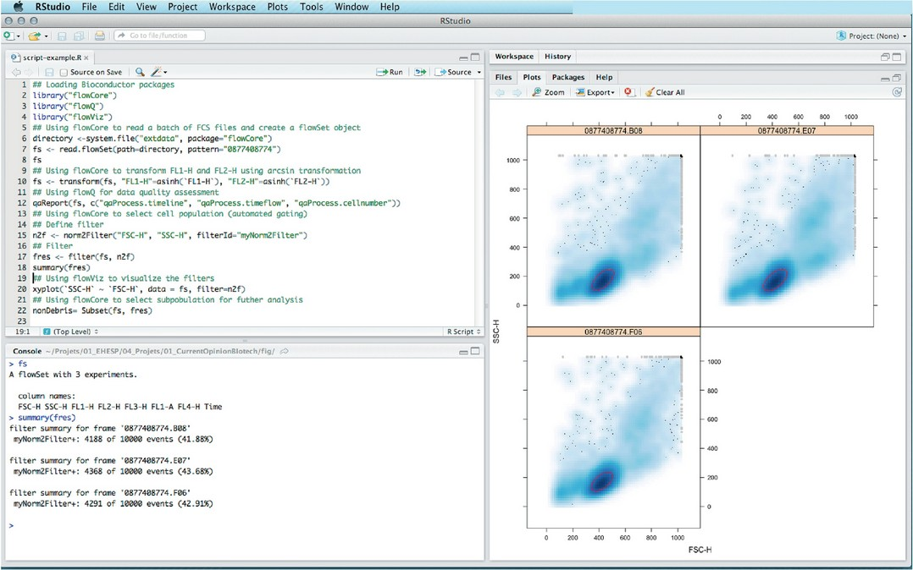
RStudio
Ryan Brinkman

Slide 37
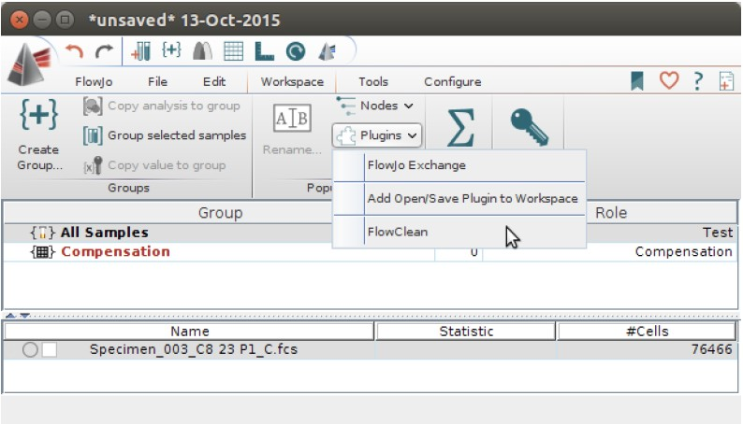
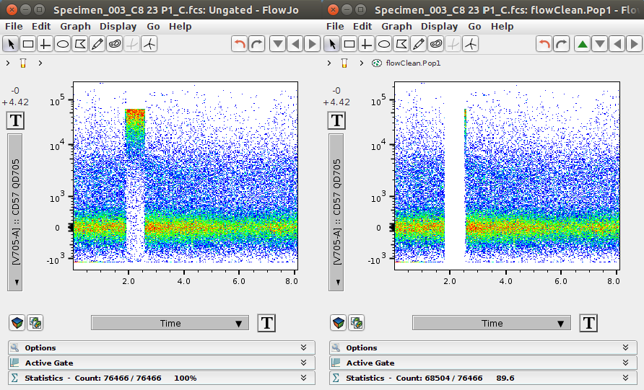
R in FlowJo
Ryan Brinkman

Slide 38
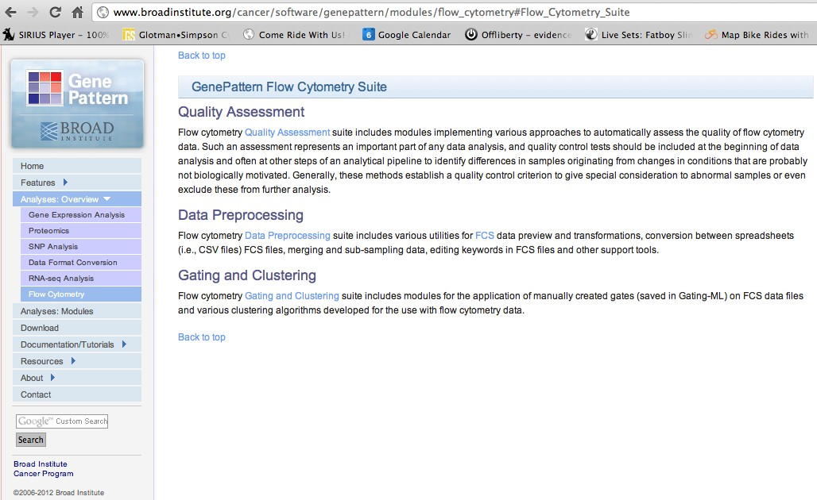
GenePattern
Ryan Brinkman

Slide 39
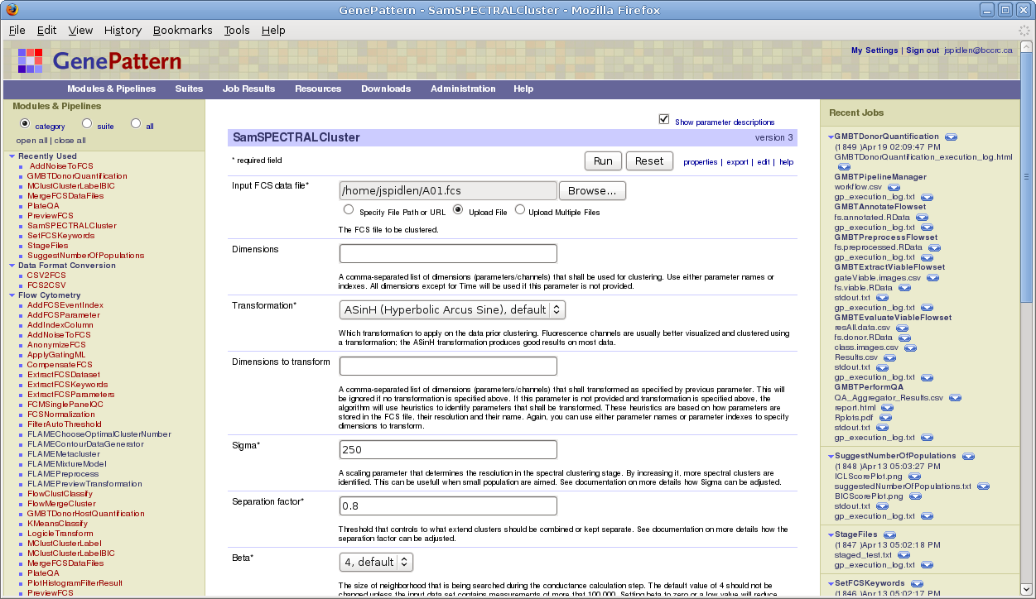
Genepattern - Example
Ryan Brinkman

Slide 40
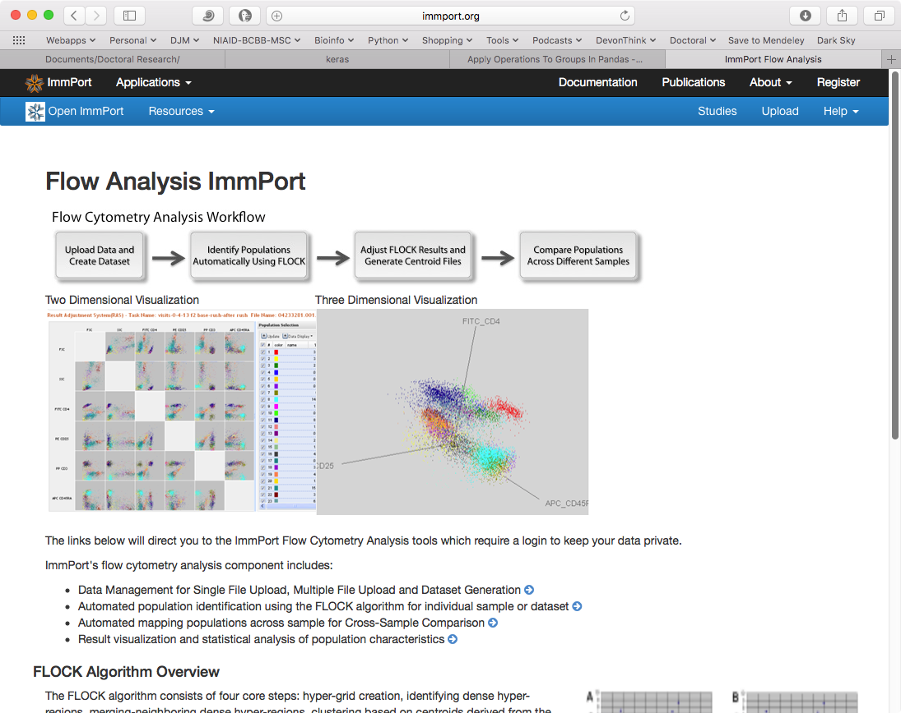
ImmPort - FLOCK

Slide 41
Resources
Intro to Flow Cytometry
http://www.abcam.com/protocols/introduction-to-flow-cytometry
https://www.bio-rad-antibodies.com/introduction-to-flow-cytometry.html
Flow Cytometry GitHub Repository / Videos
https://github.com/bioinformatics-ca/other_workshops/tree/master/flow_cytometry_2013
http://bioinformatics-ca.github.io/flow_cytometry_2013/
R Programming
http://www.cyclismo.org/tutorial/R/
https://cran.r-project.org/doc/contrib/Torfs+Brauer-Short-R-Intro.pdf
Repository
https://flowrepository.org/
Unix
http://www.ee.surrey.ac.uk/Teaching/Unix/
http://www.rain.org/%7Emkummel/unix.html

Slide 42
References
Aghaeepour, N., & Jalali, A. (2016). RchyOptimyx: Gating Hierarchy Optimization for Flow Cytometry.
Aghaeepour, N., Nikolic, R., Hoos, H. H., & Brinkman, R. R. (2011). Rapid cell population identification in flow cytometry data. Cytometry Part A, 79A(1), 6–13. http://doi.org/10.1002/cyto.a.21007
Brinkman, R. R., Aghaeepour, N., Finak, G., Gottardo, R., Mosmann, T., & Scheuermann, R. H. (2016, January). Automated analysis of flow cytometry data comes of age. Cytometry Part A, 89(1), 13–15. http://doi.org/10.1002/cyto.a.22810
De Rosa, S. C., Brenchley, J. M., & Roederer, M. (2003). Beyond six colors: A new era in flow cytometry. Nature Medicine, 9(1), 112–117. http://doi.org/10.1038/nm0103-112
Hahne, F., LeMeur, N., Brinkman, R. R., Ellis, B., Haaland, P., Sarkar, D., … Gentleman, R. (2009). flowCore: a Bioconductor package for high throughput flow cytometry. BMC Bioinformatics, 10, 106. http://doi.org/10.1186/1471-2105-10-106
Janes, M. R., & Rommel, C. (2011). Next-generation flow cytometry. Nature Biotechnology, 29(7), 602–604. http://doi.org/10.1038/nbt.1919
Malek, M., Taghiyar, M. J., Chong, L., Finak, G., Gottardo, R., & Brinkman, R. R. (2015). flowDensity: reproducing manual gating of flow cytometry data by automated density-based cell population identification. Bioinformatics, 31(4), 606–607. http://doi.org/10.1093/bioinformatics/btu677
O’Neill, K., Aghaeepour, N., Špidlen, J., Brinkman, R., & Nolan, G. (2013). Flow Cytometry Bioinformatics. PLoS Computational Biology, 9(12), e1003365. http://doi.org/10.1371/journal.pcbi.1003365
Pyne, S., Hu, X., Wang, K., Rossin, E., Lin, T.-I., Maier, L. M., … Mesirov, J. P. (2009). Automated high-dimensional flow cytometric data analysis. Proceedings of the National Academy of Sciences of the United States of America, 106(21), 8519–24. http://doi.org/10.1073/pnas.0903028106
Raveche, E., Abbasi, F., Yuan, Y., Salerno, E., Kasar, S., & Marti, G. E. (2010). Introduction to Flow Cytometry. In Flow Cytometry in Drug Discovery and Development (pp. 3–21). http://doi.org/10.1002/9780470910085.ch1
Verschoor, C. P., Lelic, A., Bramson, J. L., & Bowdish, D. M. E. (2015). An introduction to automated flow cytometry gating tools and their implementation. Frontiers in Immunology, 6(JUL), 380. http://doi.org/10.3389/fimmu.2015.00380

Slide 43
Contact Information
R. Burke Squires
richard.squires@nih.gov
Notes:
Convert to a single workflow of multiple files

